Slide 1
AACS2192 Analysis and Design of IS – Case Study
Library System

Slide 2
Intangible Benefits

Slide 3




Intangible Benefits
Improve Reliability and Security
Improve Library Image
Improve Librarian Morale

Slide 4
Sample Summary of
Questionnaire and Interview

Slide 5
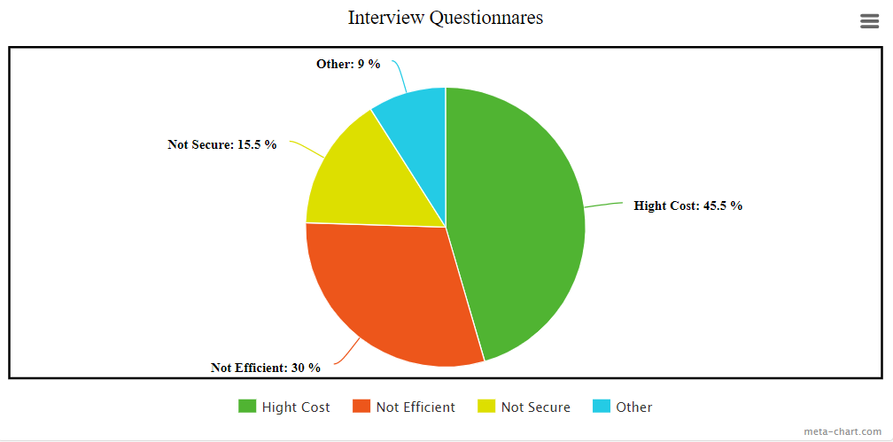
Summary of interview for employee

Slide 6
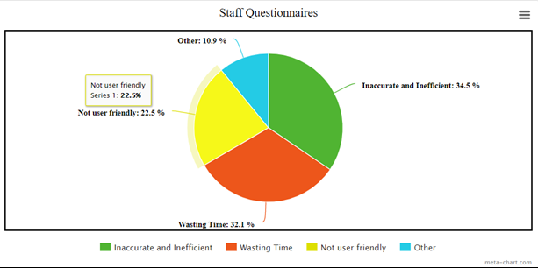
Summary of questionnaires for staff

Slide 7
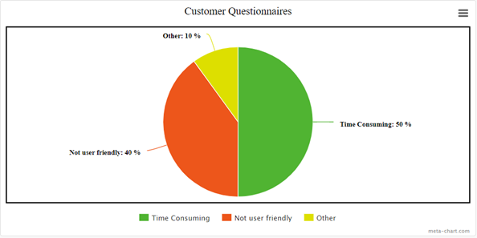
Summary of questionnaires for customer

Slide 8
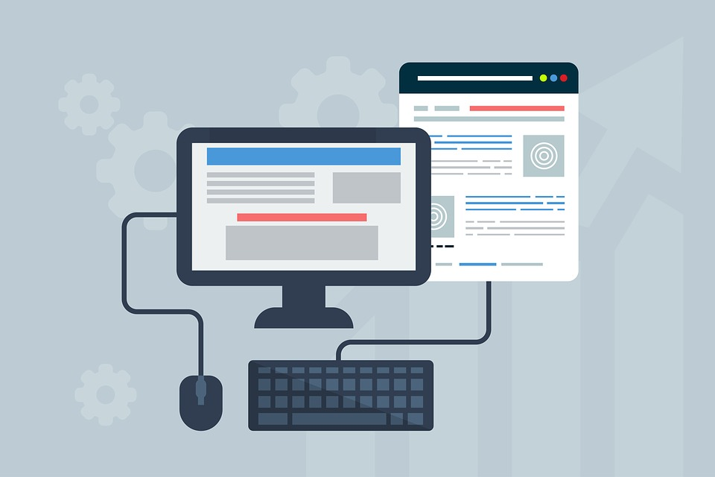
System Design - Inputs

Slide 9
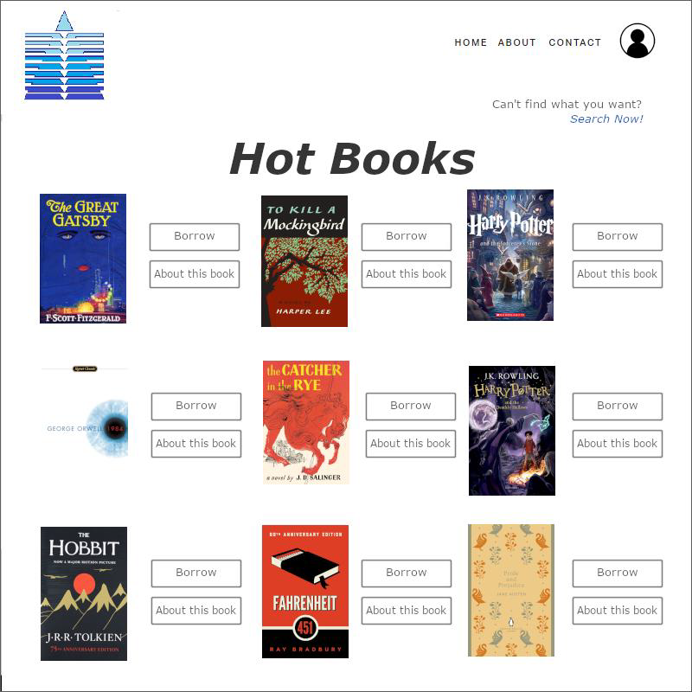
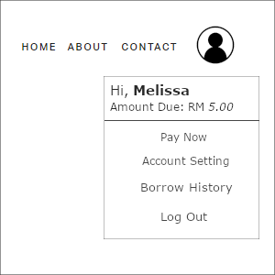

Slide 10
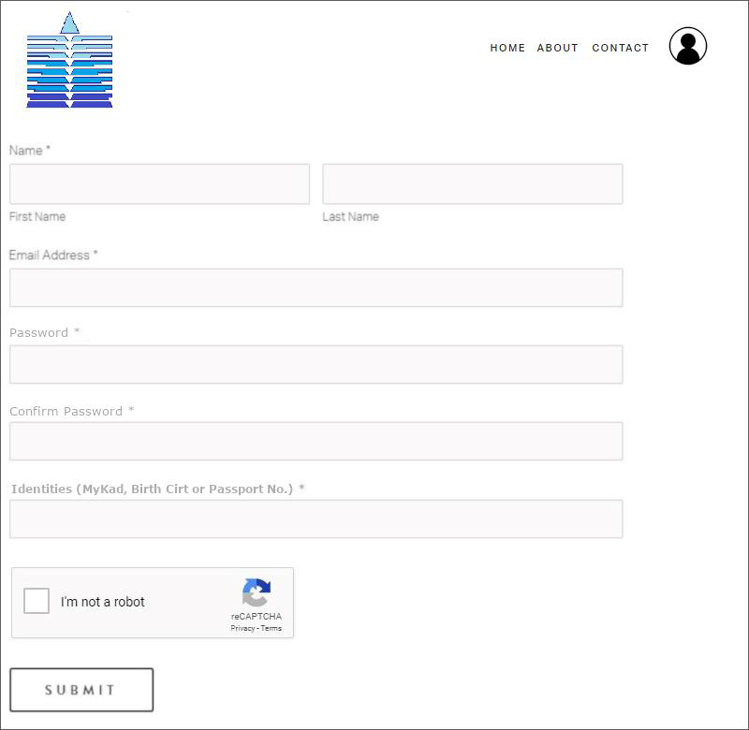
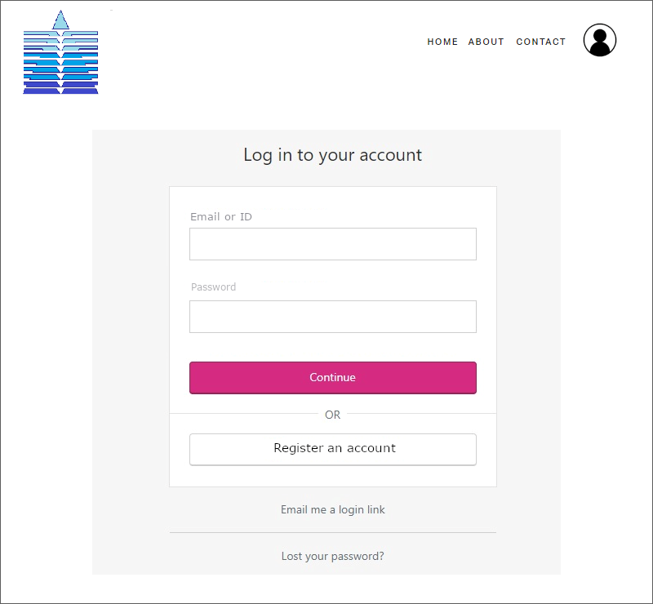
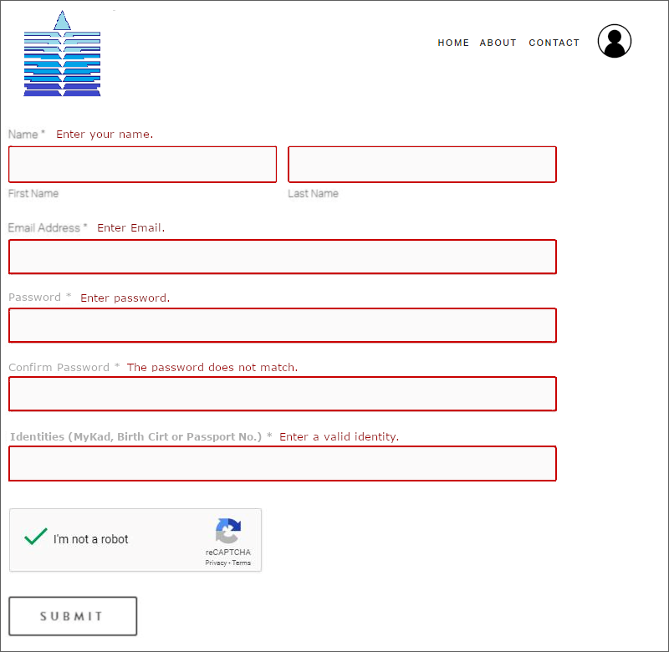
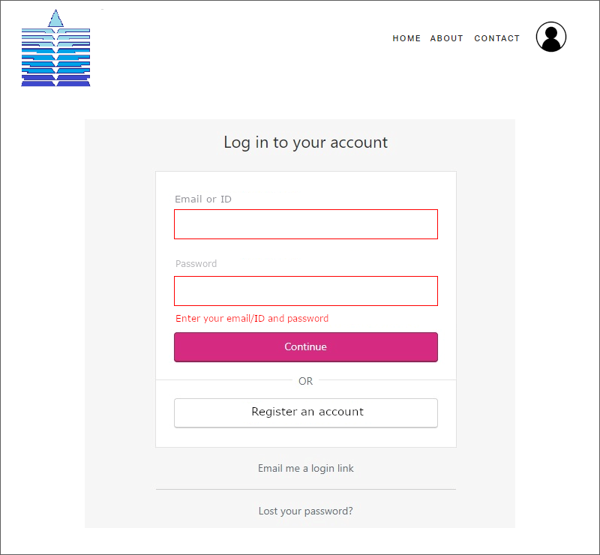
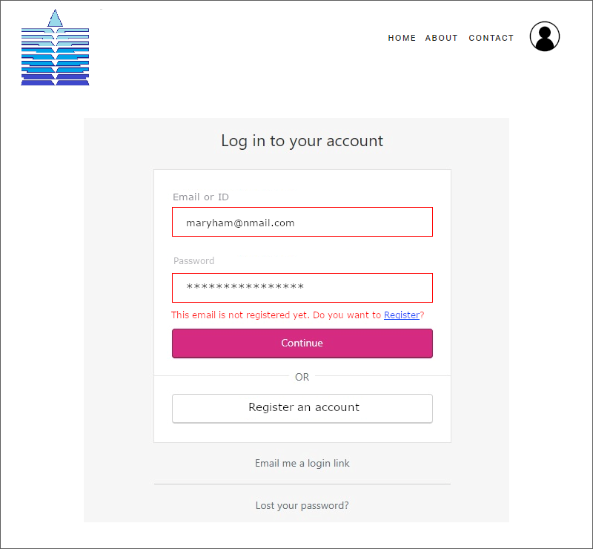
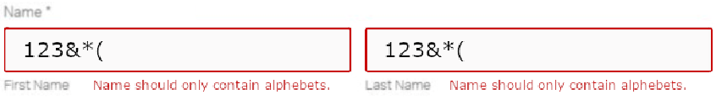





Slide 11
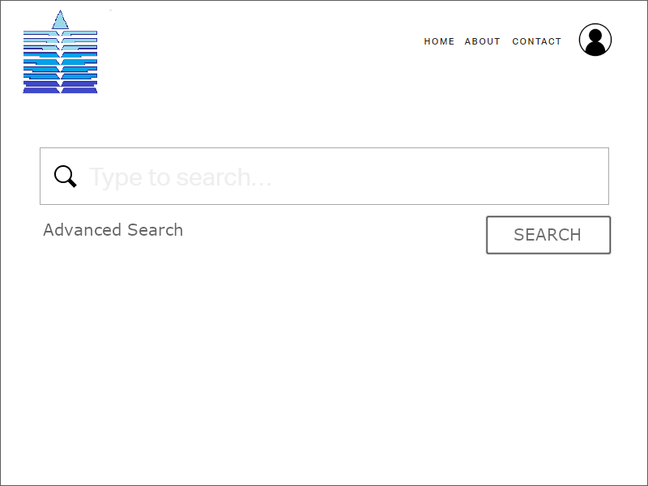

Slide 12
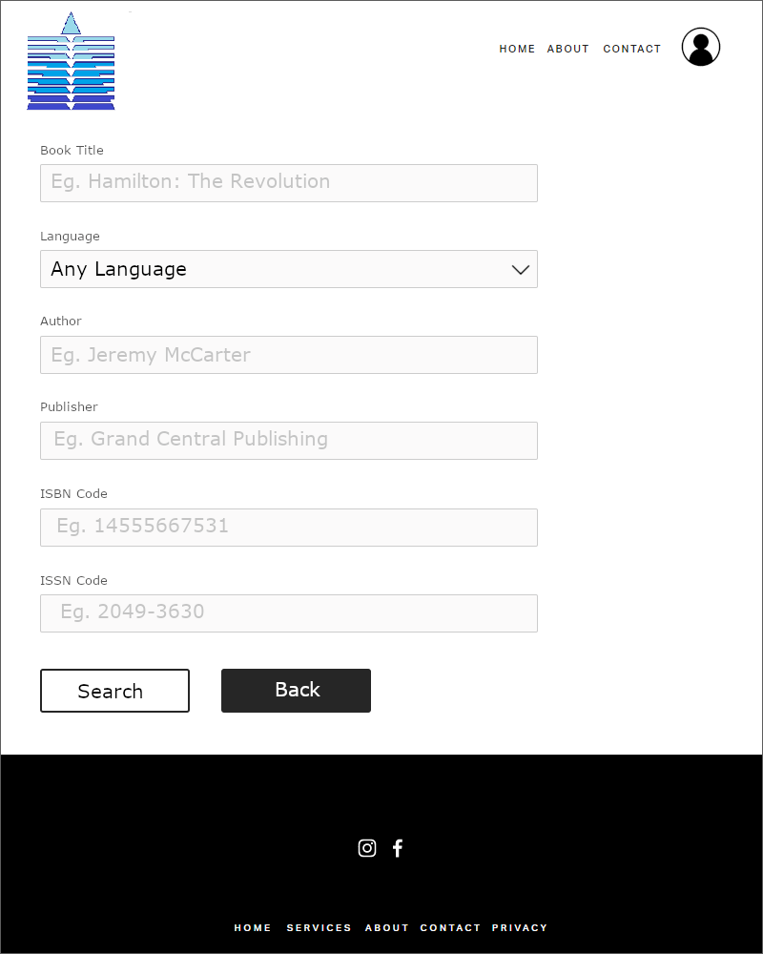

Slide 13
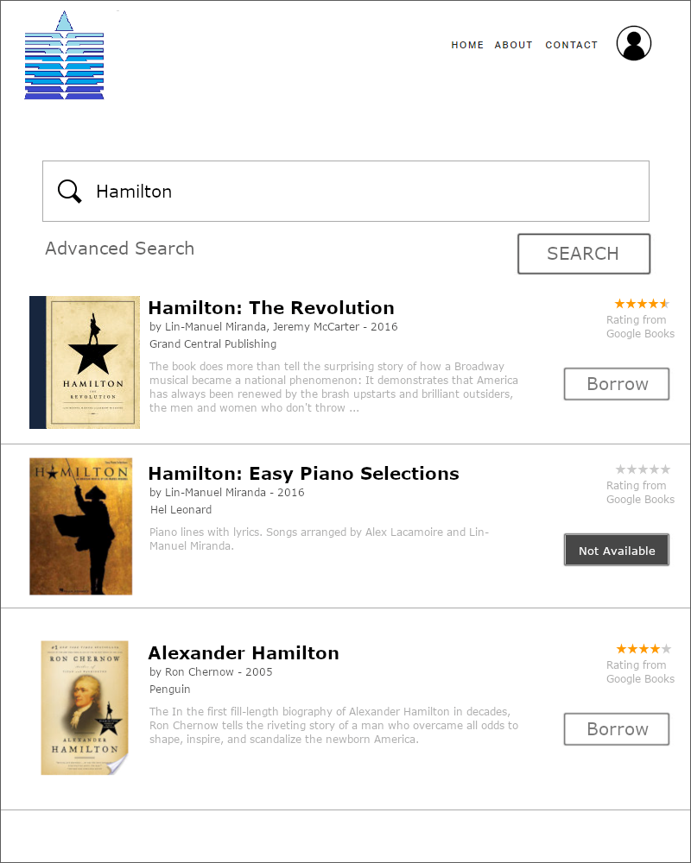

Slide 14
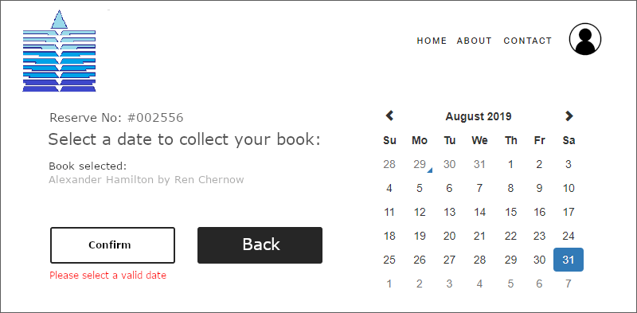
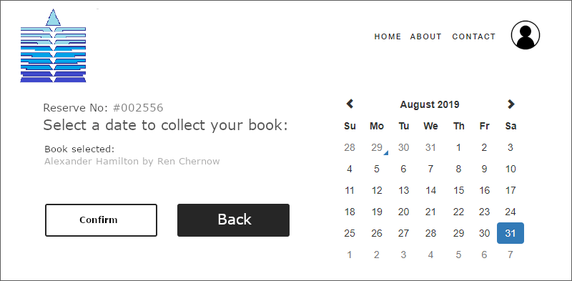
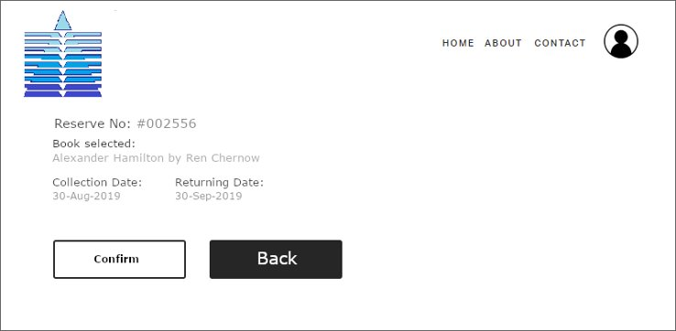

Slide 15
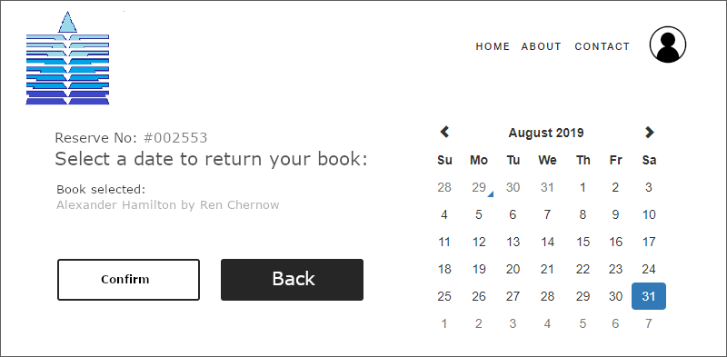
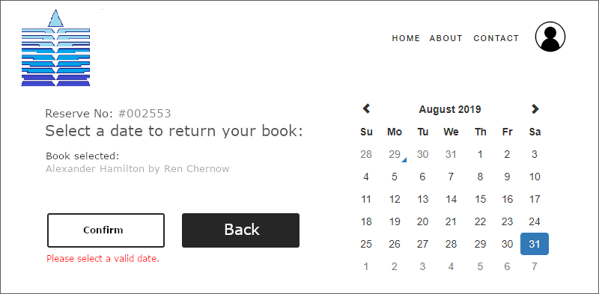
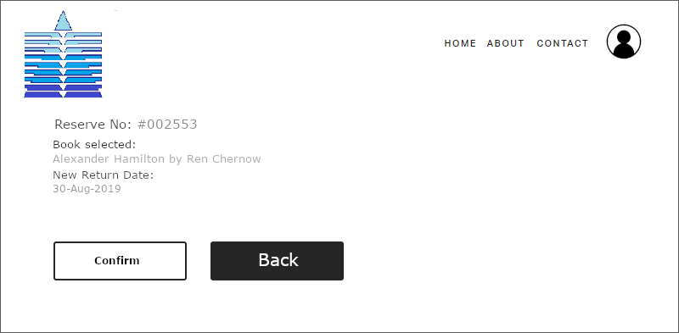

Slide 16
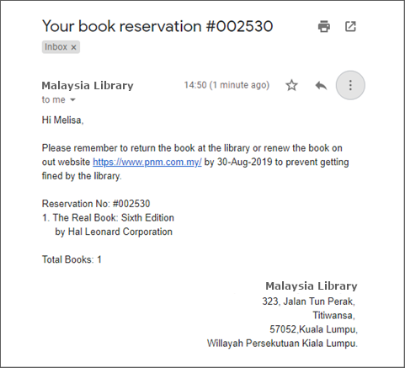

Slide 17
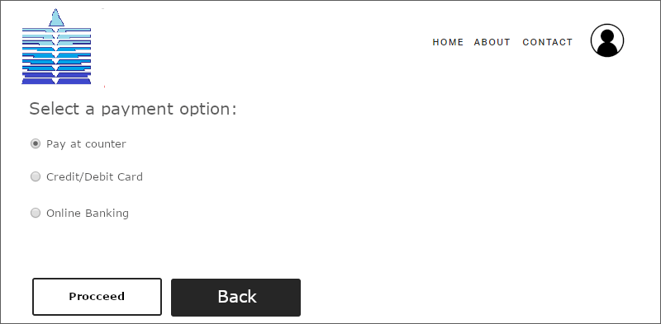
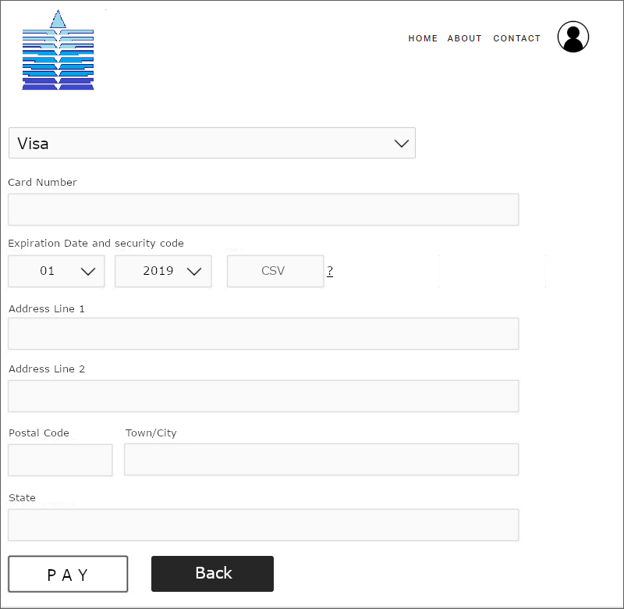
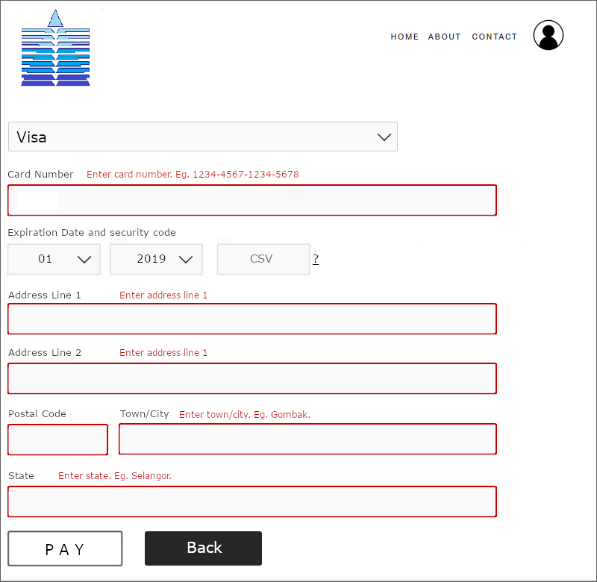



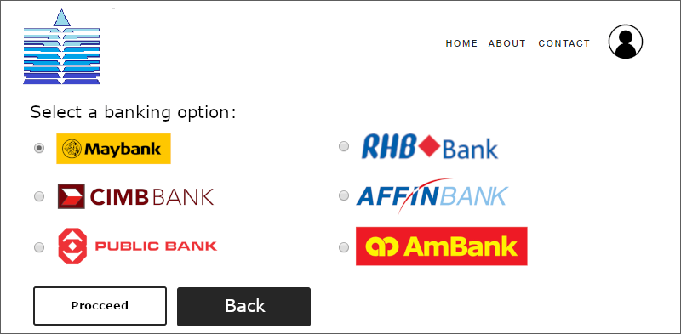

Slide 18
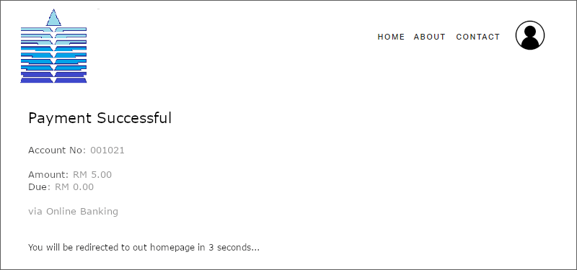

Slide 19
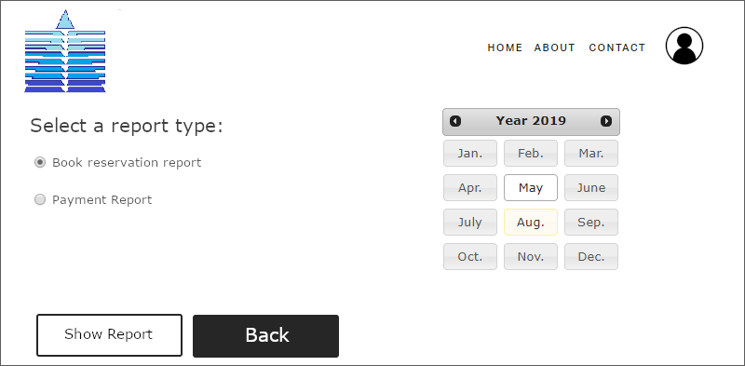

Slide 20

System Design – Outputs / Reports

Slide 21
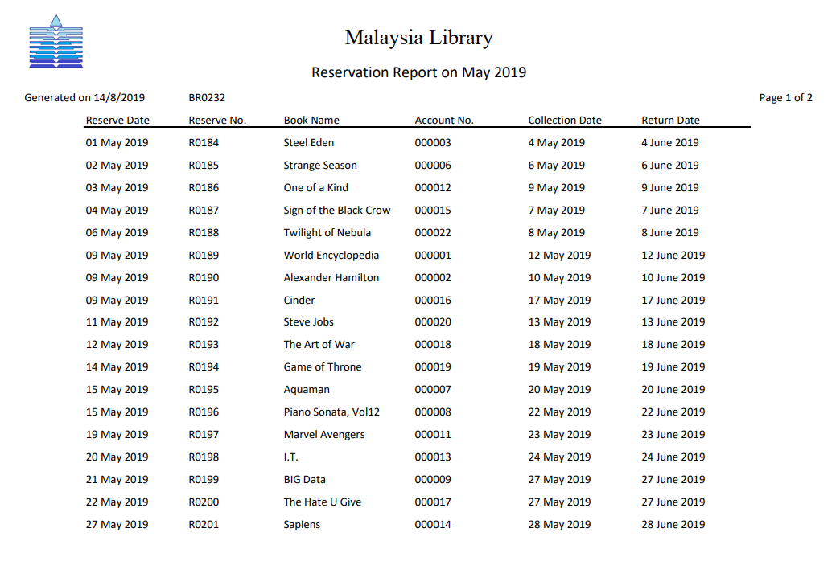
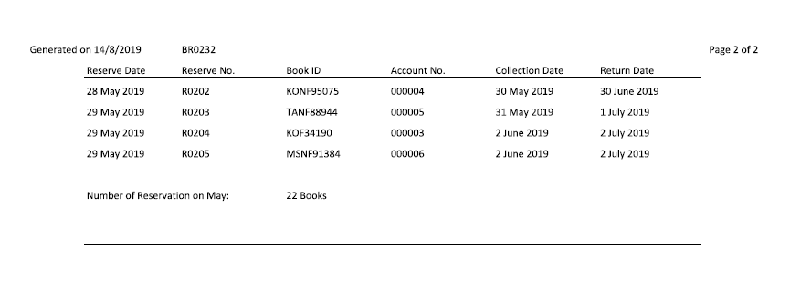
Detail Report
User:
Librarian
Purpose:
To make decision to increase the number of reservation

Slide 22
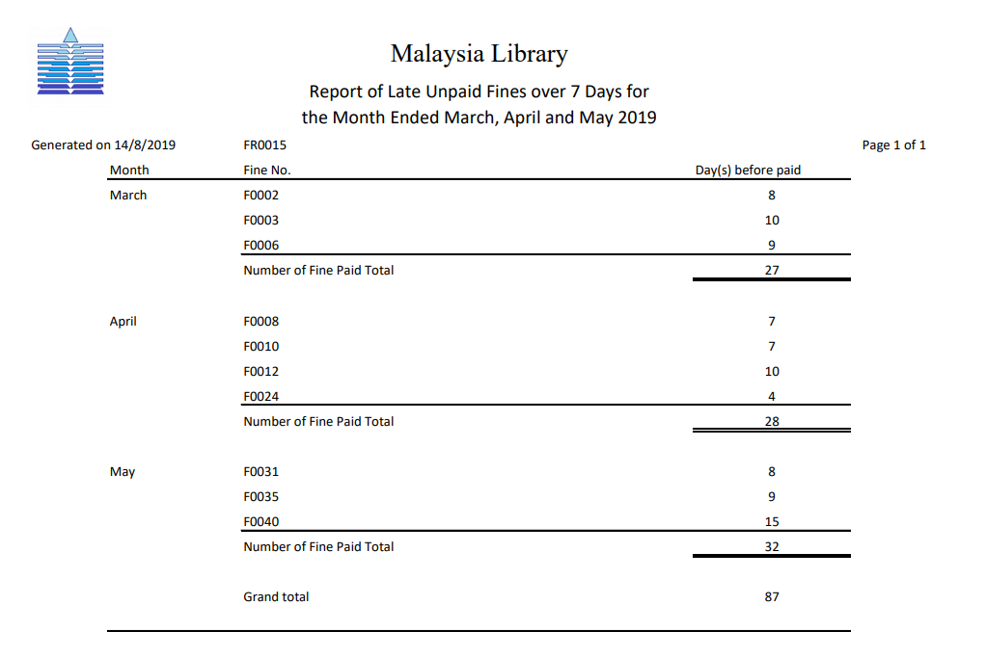
Exception Report
User:
Library Manager
Purpose:
To make decision to make more efforts to decrease the number of days before fine paid overall.

Slide 23
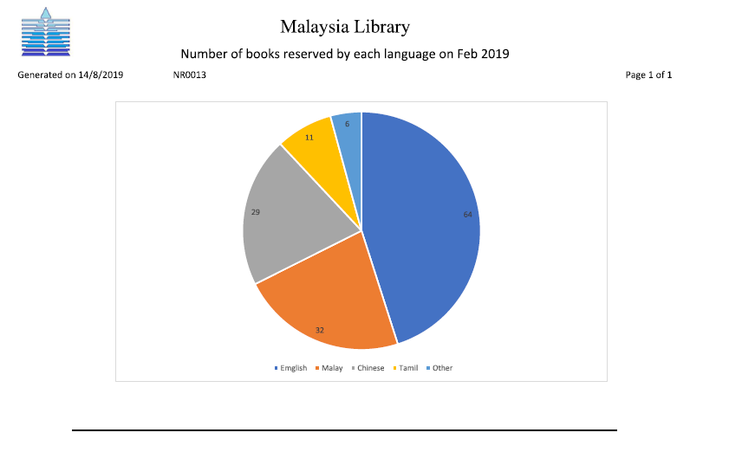
Summary Report
User:
Library Manager
Purpose:
To make sure the number of books can be reserved is adequate.

Slide 24
Principle of Good Report Design
Appropriate Report Title
- Name
- Revision
- Length

Slide 25
Principle of Good Report Design
Pleasing Report Layout
- Lable
- Spacing
- Attractive

Slide 26

Principle of Good Report Design
Meaningful Report Content
- Relevant
- Accuracy
- Title

Slide 27
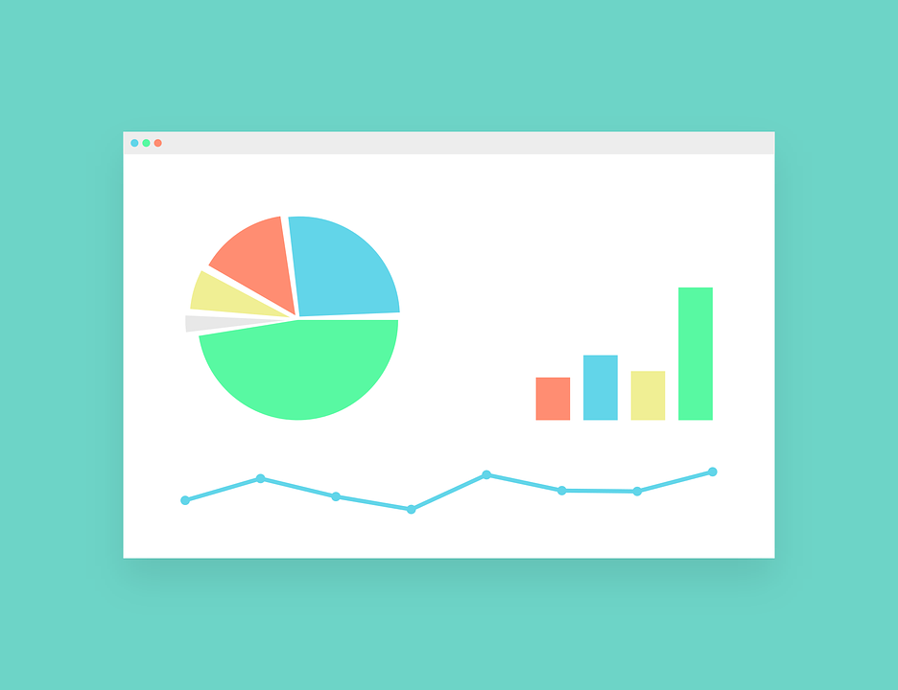
Principle of Good Report Design
Other
- Ending Line
- Reliable

